Slide 1
Final Remarks
Mr. Samuel P. Williamson
Federal Coordinator for Meteorology
67th Interdepartmental Hurricane Conference
Tropical Cyclone Research Forum
Tropical Cyclone Research: Our Vision for the Future
The Office of the Federal Coordinator for
Meteorological Services and Supporting Research

Slide 2
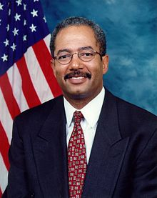
Keynote Address
Representative Chaka Fattah
U. S. House of Representatives Appropriations Committee
Subcommittee on Commerce, Justice, Science, and
related agencies (CJS)
67th IHC/Tropical Cyclone Research Forum

Slide 3
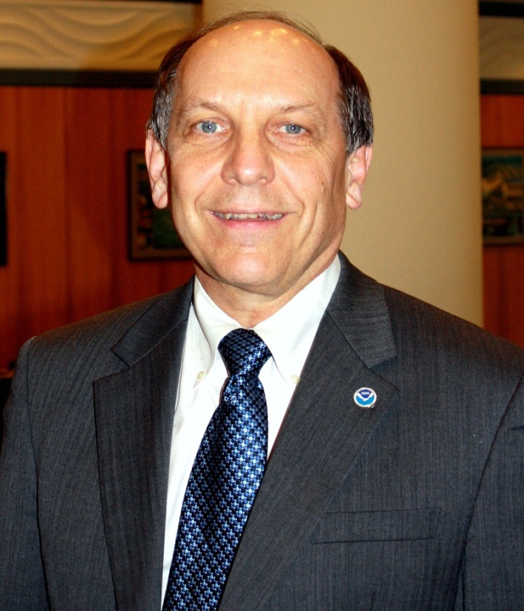
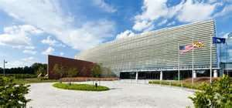
Invited Comments
Dr. Louis W. Uccellini
NOAA Assistant Administrator for Weather Services
Director, National Weather Service
67th IHC/Tropical Cyclone Research Forum
Notes:
-On February 10th, Louis Uccellini became the NOAA assistant administrator for weather services and the 16th director of NOAA’s National Weather Service.
-In his previous job, he led the National Weather Service’s National Centers for Environmental Prediction (NCEP), which this past October, moved into this beautiful, new, state-of-the-art facility.
-At NCEP, in addition to shepherding his organization into this wonderful facility, he was responsible for directing the planning, science and technology, and operational responsibilities related to NCEP’s Central Operations and Environmental Modeling, as well as seven other national centers, including the National Hurricane Center.
-And thanks to Dr. Uccellini, we have this beautiful location to conduct this important forum.
-Ladies and Gentlemen, please give a warm welcome to the mayor of the NOAA Center for Weather and Climate Prediction—Dr. Louis Uccellini.

Slide 4
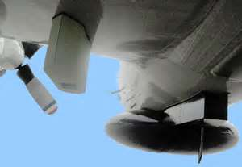
Forum Objectives
What We Accomplished
Assessed the progress in addressing the operational priorities of the operational centers (NHC, CPHC, and JTWC) and adjust future research priorities as needed
Reviewed ongoing numerical modeling initiatives within NOAA, Navy, NASA, and NSF
Received updates on Joint Hurricane Testbed projects ready for
transition from research
into operations
Explored other R&D opportunities (modeling and observational) that will promote improvements in
forecasting and understanding of TCs
and their associated affects
Investigated the application of social
science to the TC forecast and warning
notification problem

Slide 5
Forum Highlights
The Emergency Response to Hurricane Sandy
Moderator: Bryan Norcross, TWC Hurricane Specialist
Panelists: Captain Thomas Scardino, NJ EM
Mr. Richard French, NYS EM
Senior Leader Panel
Tropical Cyclone Research: The View from the Top
Moderator: John D. Murphy (NWS/OST)

Slide 6
Forum Highlights
Special Research Sessions
Working Group for Tropical Cyclone Research (WG/TCR)
Comparison of the 2008, 2010 and 2012 Snapshots of TC R&D
The Navy’s Model Development and Improvement Program/
Hurricane Forecast Improvement Program:
Supporting Talks
Earth System Prediction Capability/
Next-Generation Suite of Models:
Supporting Talks

Slide 7
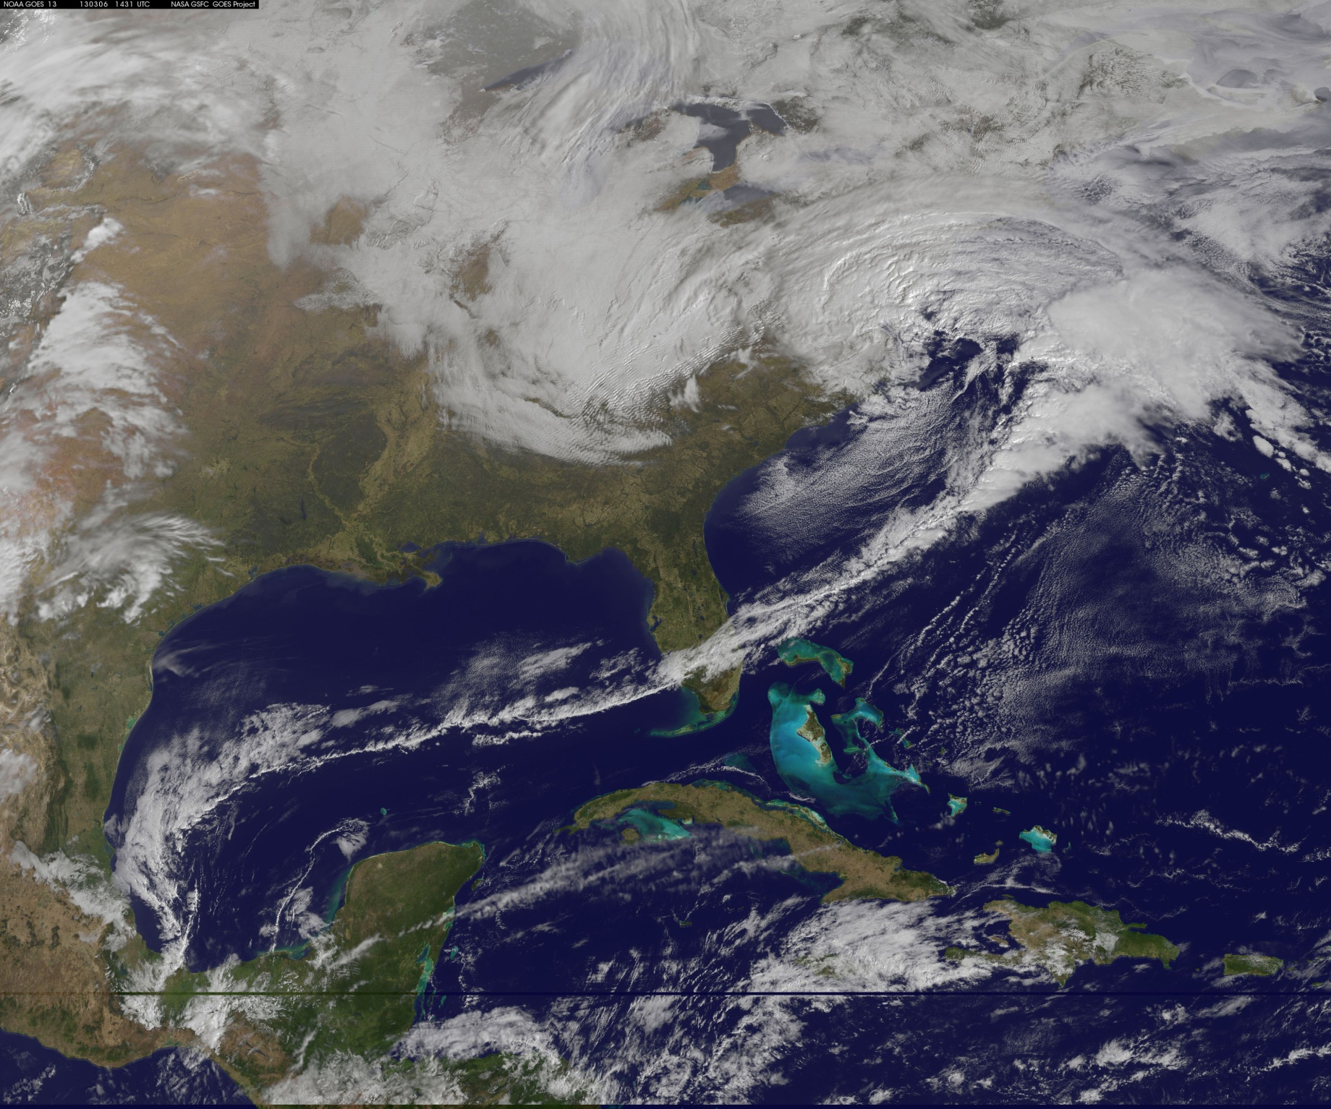
Forum Highlights
A late winter storm changed the Forum’s venue…
Notes:
7

Slide 8
Forum Highlights
100% Virtual Participation!
NSF Program Initiatives:
Supporting Talks
The 2012 Forecast Season in Review
Joint Hurricane Testbed Project Updates, Parts 1 & 2
TC Model Development and Technology Transfer
Notes:
8

Slide 9
Forum Highlights
Observations and Observing Strategies for
Tropical Cyclones and their Environment
Improvements in TC Forecast and Warning
Products and Services
Forum Luncheon

Slide 10
Forum Highlights
Richard H. Hagemeyer Award
2013 Winner
Dr. James McFadden
Chief, Programs and Projects
NOAA Aircraft Operations Center

Slide 11
Forum Highlights
Invited Speaker
Mr. Dave Jones
President & CEO
StormCenter Communication, Inc.
Collaborative Decision Making: Connecting Agencies (Federal and State) and the Private Sector for Improved Situational Awareness, Coordination, and Response to Save Lives and Property

Slide 12
Forum Highlights
Social Science Applications to the TC Forecast
and Warning Notification Problem
Final Plenary Session
WG/HWSOR: Action Item Review
Conference Wrap-up
Final Wrap-Up
Adjourn

Slide 13
Successes and Challenges
Partnerships and Alliances Still Vital
Importance of Tropical Cyclone Research Working Group
Transition from Research Results into Operations
Joint Hurricane Testbed (JHT)
HFIP
Exploitation of Research for Operations
Research Results Showing the Way Forward
Technology Innovation Showing Results

Slide 14
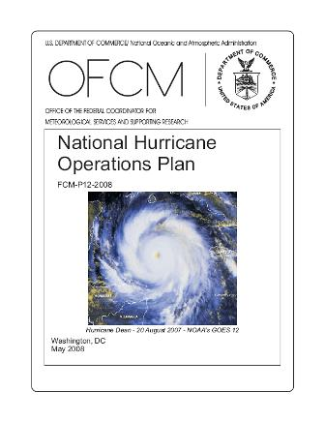
Next Steps
Update the National Hurricane Operations Plan, reflecting changes accepted by the Working Group for Hurricane and Winter Storms Operations and Research by May 15, 2013
Task the WG/TCR to conduct a mid-term assessment of the 2007 Research Plan, to include the implementation of storm surge results.
Continue to integrate social sciences into meteorological operations and services
Effective Communications: Key to saving lives

Slide 15
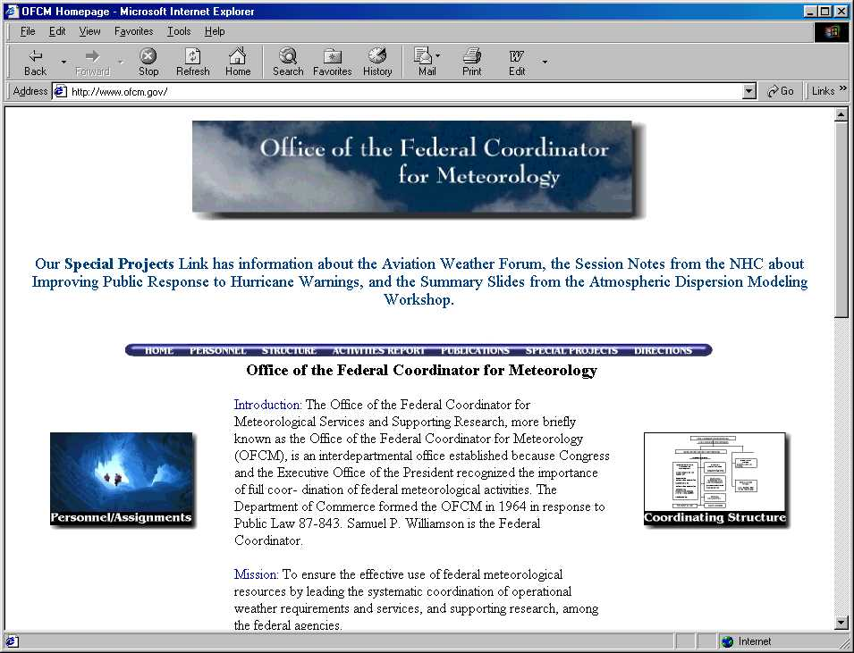
Conference Materials
Presentations and other material will be available on the OFCM web site shortly after the IHC.
Click on “Special Projects” and navigate to the 67th IHC.
http://www.ofcm.gov//

Slide 16
Key Forum Players
Chair: Mr. Samuel P. Williamson
Forum Technical Director Assistant Director | Mr. Bob Dumont Ms. Erin McNamara
Forum Coordinator for Logistics | Ms. Erin McNamara
Audiovisual | Mr. Ken Barnett Mr. Tony Ramirez
Registrars | Ms. Susan Baltuch, UCAR Ms. Kendra Greb, UCAR
Session Coordinators | Dr. Paul Try Col Gary Kubat Ms. Susan Callis Mr. Floyd Hauth Dr. Daniel Melendez Mr. Bob Dumont
Notes:
16

Slide 17
Special Recognition
Sponsoring Agencies – NOAA, NSF, ONR
WG/Tropical Cyclone Research WG/Hurricane & Winter Storms Ops and Research
Speakers, Session Leaders, Moderators, and Panelists
Key Forum Players
UCAR
Saki Kwon, Kloud Café
NOAA Center for Weather and Climate Prediction
and YOU!

Slide 18
Next IHC
68th IHC
TBD

Slide 19
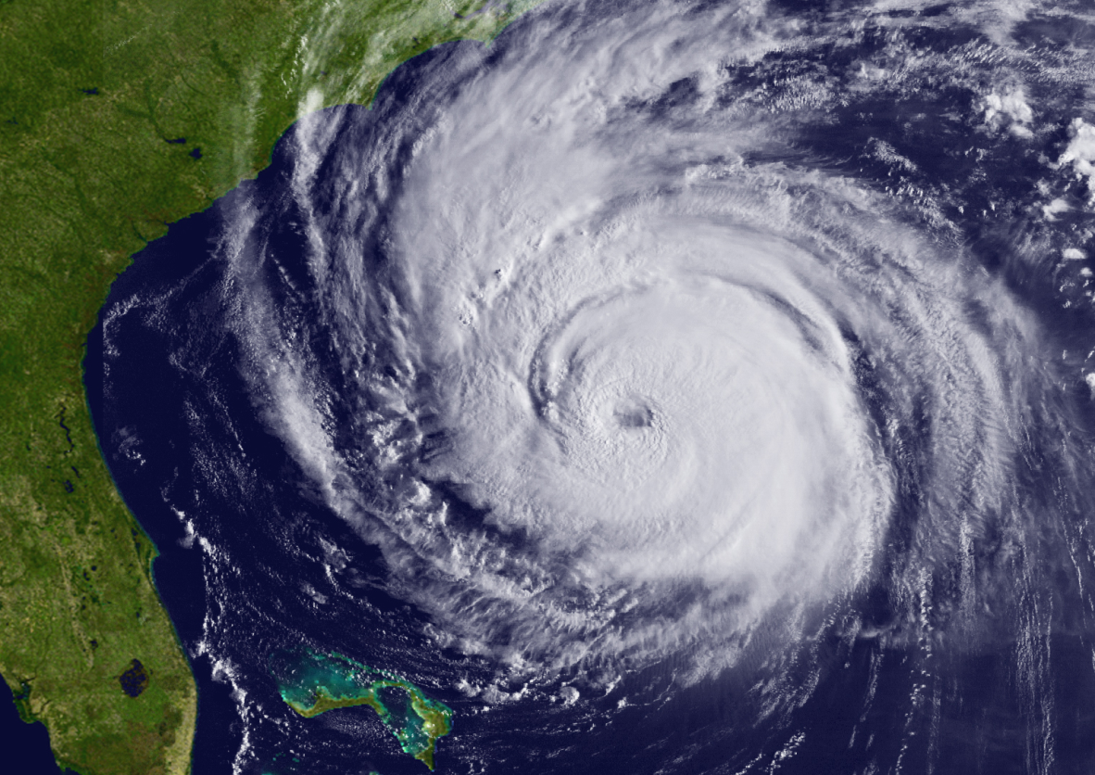
The 67th IHC/TCRF Is Adjourned
Thank you for attending and participating in the 67th Interdepartmental Hurricane Conference/Tropical Cyclone Research Forum!
On behalf of the Office of the Federal Coordinator for Meteorology,
Have a safe trip home!

Slide 20
Notes:
20

Slide 21
BACK- UP SLIDES

Slide 22
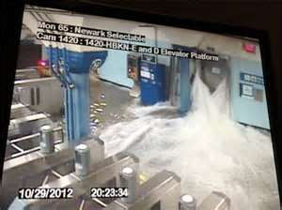
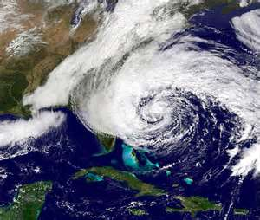
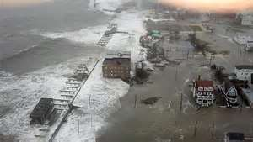
Reminder of Why Are We Here
Hurricane Sandy is just the most recent example of the need to work together to provide improved services to help prevent injuries and the loss of life.
We must build upon the synergy and collaboration we’ve achieved in the tropical cyclone community over the last 5 years to reassess the gaps in our capabilities and adjust our priorities, as necessary, moving forward to:
Ensure we get the “biggest bang for the buck” in a tough budgetary climate
Ultimately, minimize the Nation’s vulnerability to natures most destructive forces
Notes:
22

